Slide 1


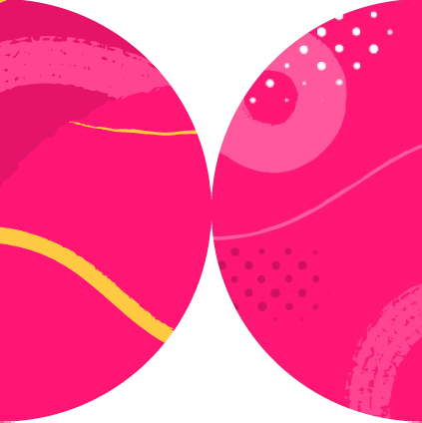

Testing Component Rendering

Slide 2



What Are We Testing?
Rendering
User Interaction

Slide 3

Required Tools
JavaScript test runner
JavaScript runtime
Test assertion library
DOM and HTML environment
UI testing library

Slide 4
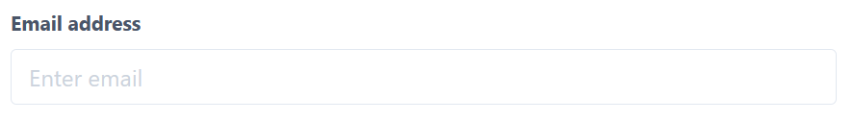
<label for="email"> Email address
</label>
<input
type="email" id="email"
/>
User-centric Testing

Slide 5
Testing Library
React Testing Library
Vue Testing Library
Angular Testing Library
Svelte Testing Library
Cypress Testing Library
Preact Testing Library
DOM Testing Library

Slide 6
Rendering a Component
import { render } from '@testing-library/react'
render(<Home />)

Slide 7
Element Query Types
get
getAll query
queryAll find findAll
Throws an error unless there is exactly one match
Returns all matches. Throws an error if there are no matches.
Return matching node. Throws an error if there are multiple matches. Return all matches.
Asynchronous version of `get`. Asynchronous version of `getAll`.

Slide 8
Element Selection Types
get
getAll query
queryAll find findAll
Role
LabelText PlaceholderText
Text DisplayValue AltText
Title
TestId
…By…

Slide 9
ARIA Role Types
const heading = screen.getByRole('heading', { name: "Filter List",
})

Slide 10
Test That an Element Renders
import { render, screen } from '@testing-library/react' import Home from '@/pages/index'
test('Home renders a heading', () => { render(<Home />)
screen.getByRole('heading', { name: "Filter List",
})
});

Slide 11
Finding Nested Elements
import { render, screen, getByRole } from '@testing-library/react' import Home from '@/pages/index'
test('Home renders a heading nested',() => { render(<Home/>);
const main = screen.getByRole('main'); getByRole(main, 'heading', {
name: "Filter List"
});
});

Slide 12
TextMatch
Input.js
Input.test.js
<label htmlFor="name">Name</label>
<input type="text" id="name" />
screen.getByLabelText("name"); screen.getByLabelText(/^name$/i);

Slide 13

Demo
Testing Rendering

Slide 14
Debugging Components
<input
name="Filter" placeholder="Filter"
type="text" value=""
/>
screen.debug(screen.getByPlaceholderText("Filter"));

Slide 15
Logging ARIA Roles
list:
Name "Filtered list":
<ul
aria-label="Filtered list"
/>
const list = screen.getByRole('list’, { name: /Filtered list/I
});
logRoles(list);
-------------------------------
listitem:
Name "":
<li />
Name "":
<li />

Slide 16
Log Playground URL
https://testing- playground.com/#markup=DwEwlgbgfK kAQGMA2BDAzmgvAIgGZiQBcBTAJyTDUOx gAcYwA7WgV0LkZQFticAxAiVLY4hAJ61e 2EgA9qcWqgTEAFgHskIMv0FkREFEhZSaw APT1gLJHBSkwKALSoARsSQ6iZYiDgUqph RQALJkCCykYuZBwEEAasSMLGjRYDBBAKJ
2hCqp6WnBdilmMUEAUiy0YEJ5sWkAyiiE EYy1QQCqpChJxaVpAHLEtM2MxLVm1jBm4 NDmM1BAA
render(<FilterList {...props} />); screen.logTestingPlaygroundURL();

Slide 17
Testing Asynchronous Rendering
App.js
App.test.js
render(
<LazyContent delay={500}>
... or not to be
</LazyContent>
);
await screen.findByText('... or not to be');
<LazyLabel delay={500}> Some lazy-loaded content
</LazyLabel>

Slide 18
Testing Asynchronous Rendering
App.js
App.test.js
render(
<LazyContent delay={500}>
... or not to be
</LazyContent>
);
await waitFor(() => { screen.getByText('... or not to be’);
});
<LazyLabel delay={500}> Some lazy-loaded content
</LazyLabel>

Slide 19
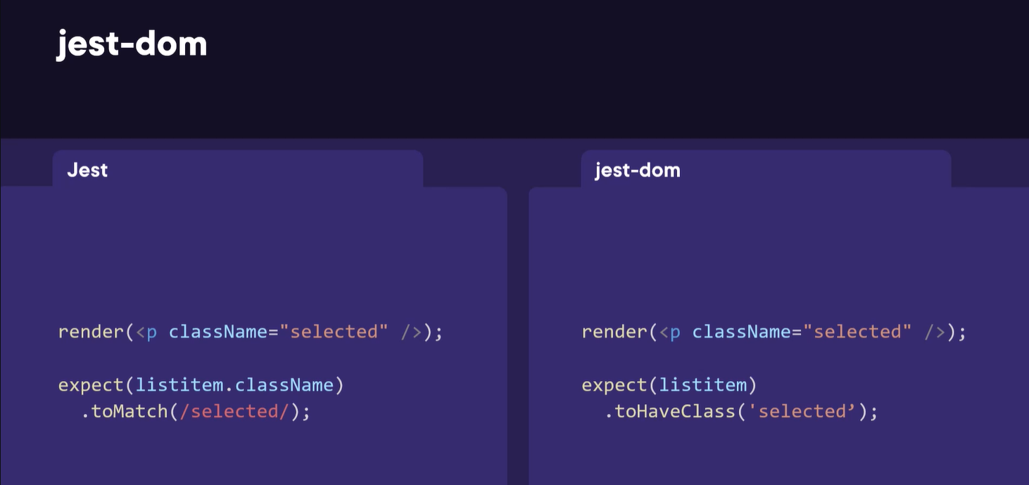

Slide 20

Summary
Test UI components in a user-centric way

